Slide 1




Universal upper bound on the Bose–Einstein condensate and the Hubbard star
Christian Schilling
University of Oxford
Windsor, 4th August 2017
Phys. Rev. B 96, 064502 (2017)
in collaboration with
Felix Tennie and Vlatko Vedral
Notes:
1

Slide 2
















Slide 3
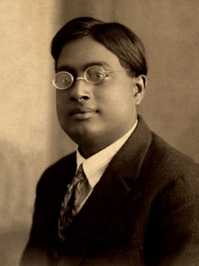
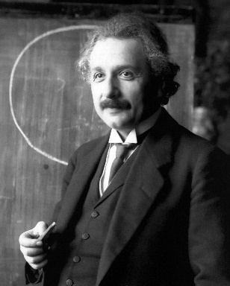


Slide 4



Slide 5




Slide 7











Slide 8
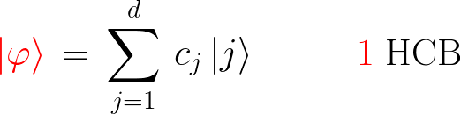
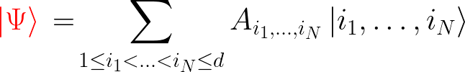




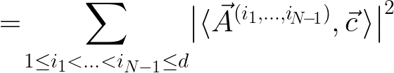


Slide 9


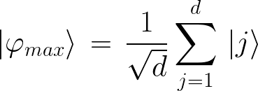
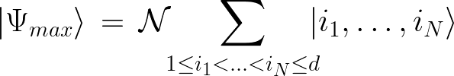



Slide 10





Slide 11


[B. Toth, J. Phys. Stat. 61, 749 (1990)]
[O. Penrose, J. Phys. Stat. 63, 761 (1991)]
[C. N. Yang, C. P. Yang, Phys. Rev. 151, 258 (1966)]

Slide 12
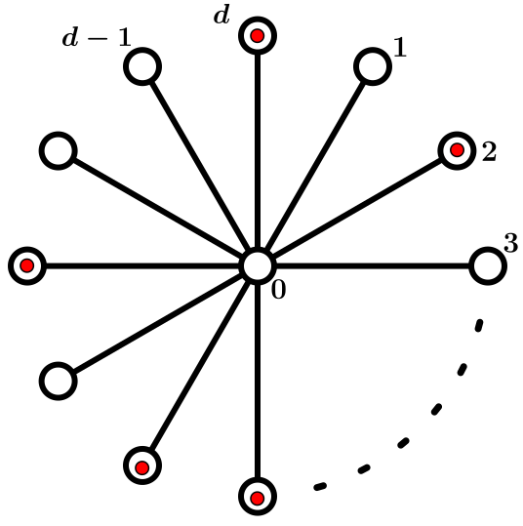

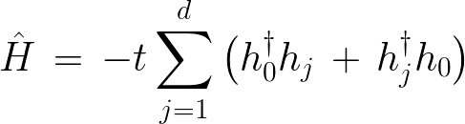





Slide 13

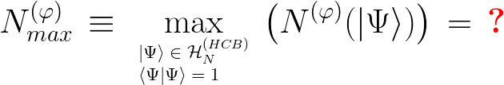


Slide 14








Slide 15



Slide 16
Thank you!
Phys. Rev. B 96, 064502 (2017)
F.Tennie, V.Vedral, CS

