Slide 1




A unifying Perspective on the
Electron Correlation Problem
Christian Schilling
LMU Munich
in collaboration with:
L.Ding, Z.Zimboras
S.Das, O.Legeza; S.Mardazad, U.Schollwoeck, S.Szalay
C.Benavides-Riveros, J.Liebert, R.Schilling
Notes:
1

Slide 2








Slide 3


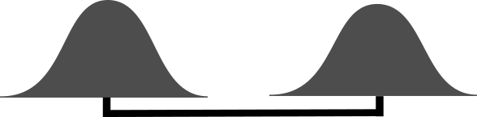
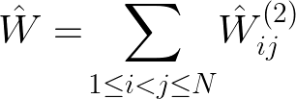








Slide 4
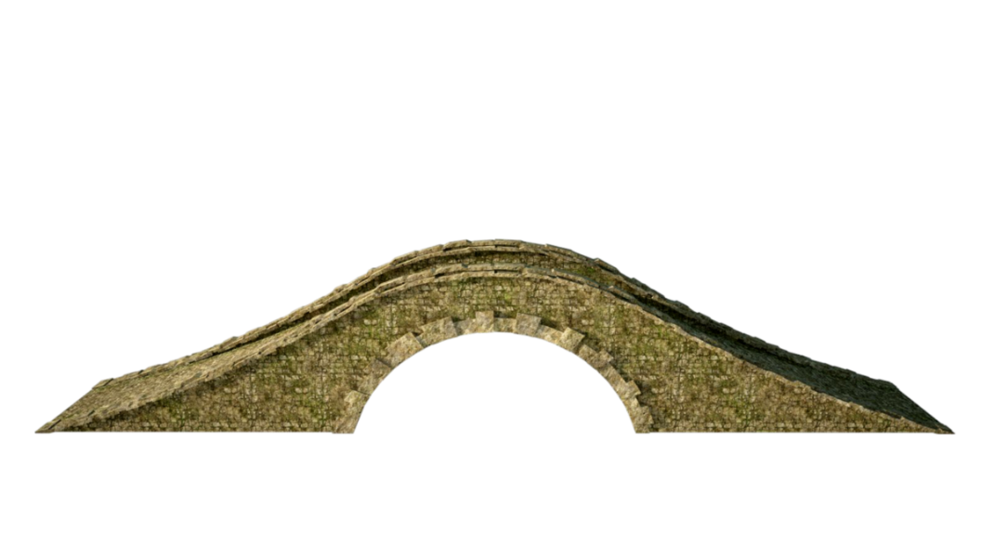


















Slide 5
1) Particle Picture

Slide 6






1a) Electron correlation problem: simplifications

Slide 7



1b) Notion of Entanglement & Correlation (?)

Slide 8

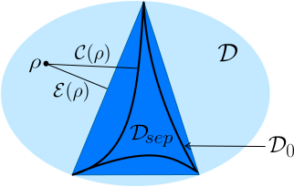
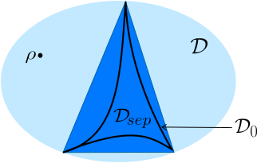
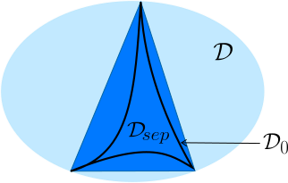

Slide 9



Slide 10






Slide 11



1c) Novel concepts: exchange force
and BEC force

Slide 12

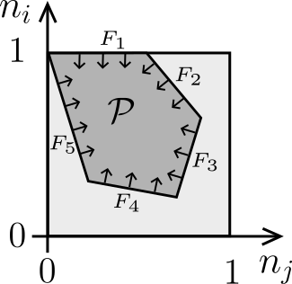
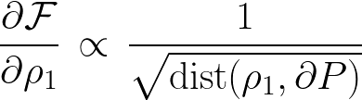
Theorem/conjecture:

Slide 13
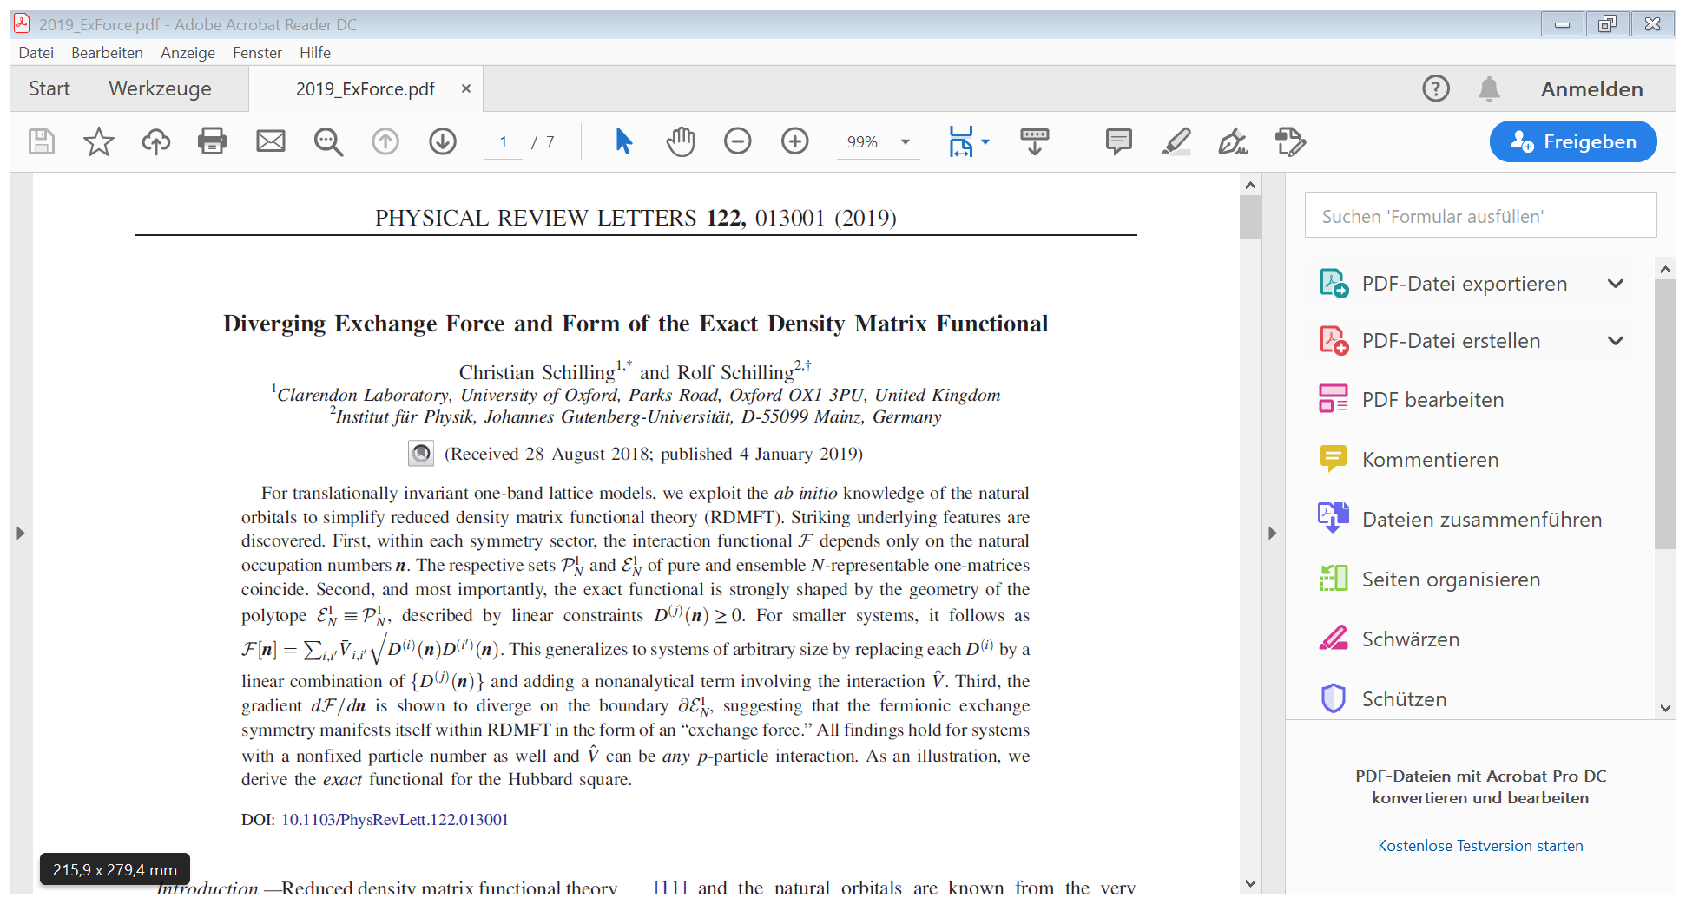
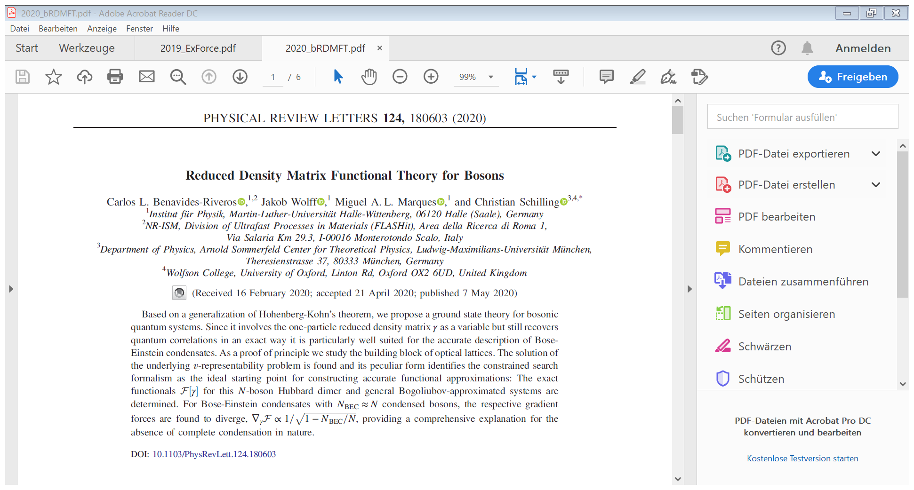

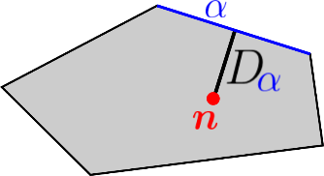

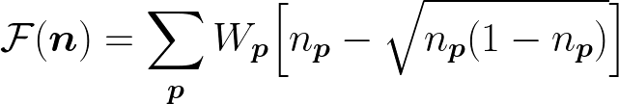

Slide 14
2) Orbital/Mode Picture

Slide 15



2a) Electron correlation problem: simplifications

Slide 16



2b) Notion of Entanglement & Correlation

Slide 17



Slide 18


2c) Application/Illustration

Slide 19




Slide 20
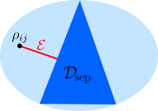


Slide 22



Slide 23
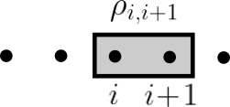


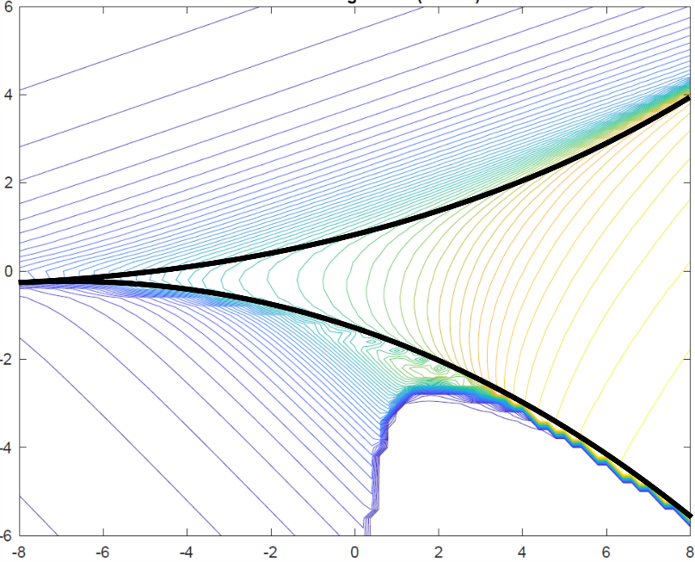



Slide 24
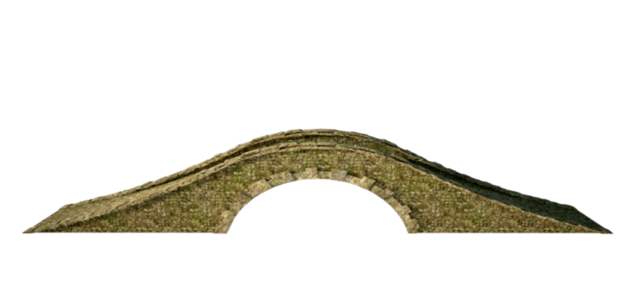

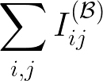





Slide 25


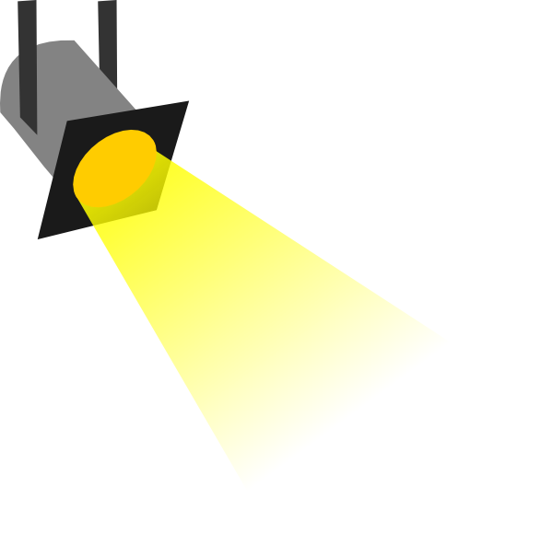


Slide 26





Slide 27







Slide 28





Slide 29

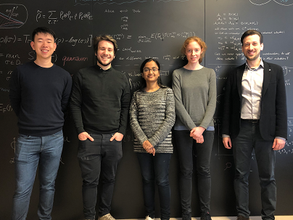





Slide 30

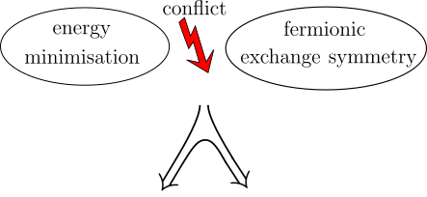
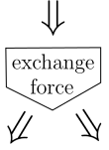
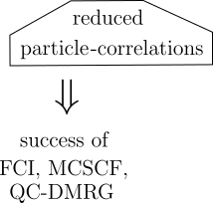
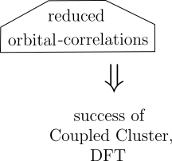
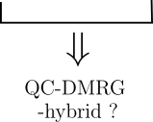
(III)
(I)
(II)

Slide 31
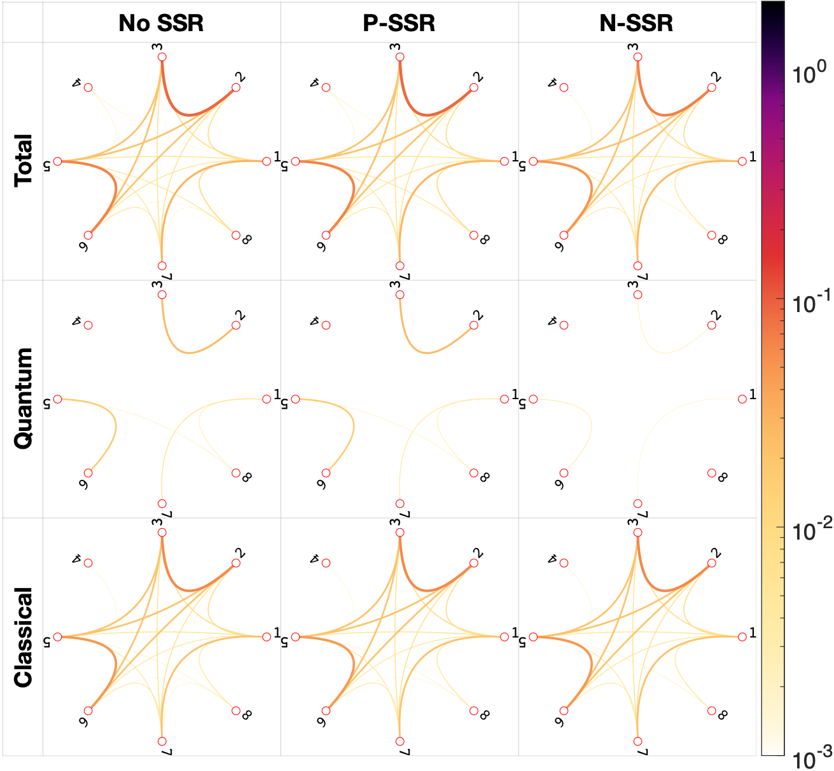


Slide 32
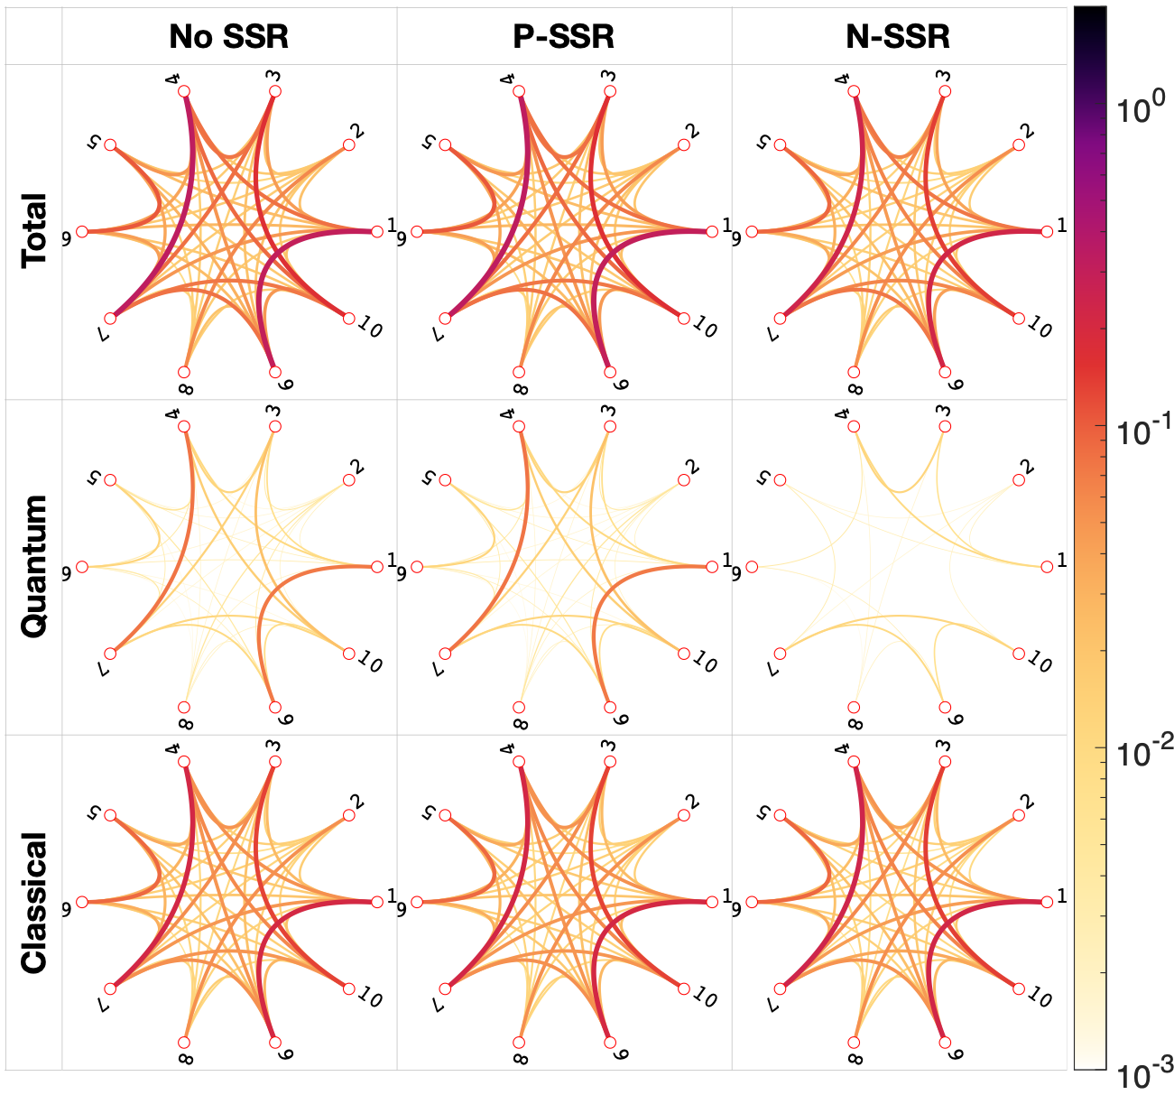


Slide 33
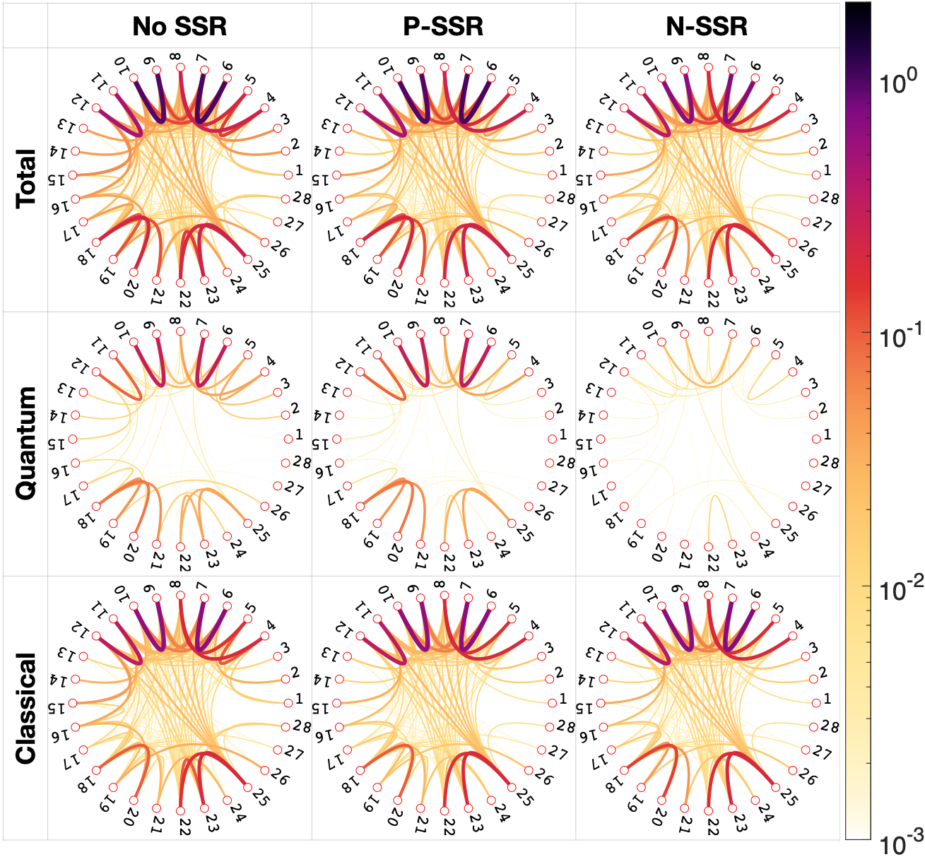

Slide 36



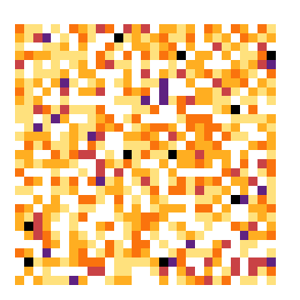
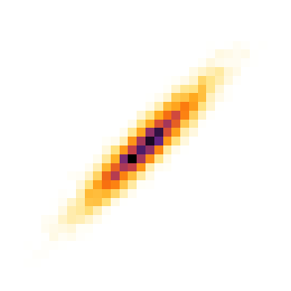


Slide 37





Application/Illustration

Slide 38





Slide 39




Slide 40





Slide 41
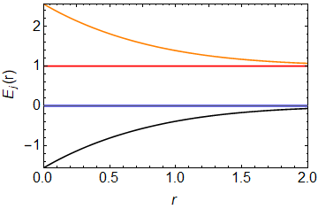

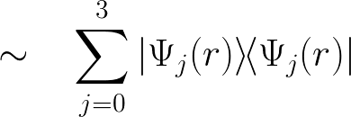


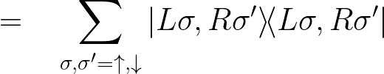

Slide 42
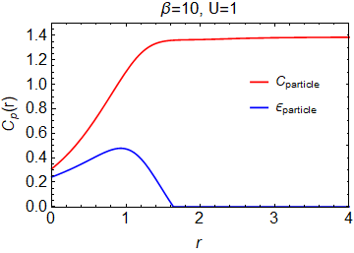




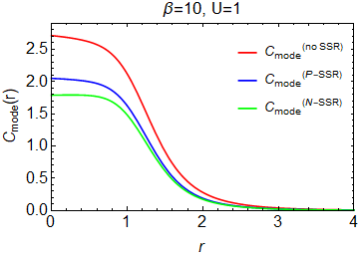
p
m

Slide 43







1
natural occupation
numbers
0
1

Slide 44




example: N = 3 & d= 6
[R.E.Borland, K.Dennis, J. Phys. B, 5, 1, 1972]
[M.B.Ruskai, Phys. Rev. A, 40, 45, 2007]
in general: finite family of generalized Pauli constraints
[A.Klyachko, J. Phys 36, 72-86, 2006]
[M.Altunbulak, A.Klyachko, CMP 282, 287-322, 2008]
[M.Altunbulak, PhD thesis, Bilkent University, 2008]

Slide 45
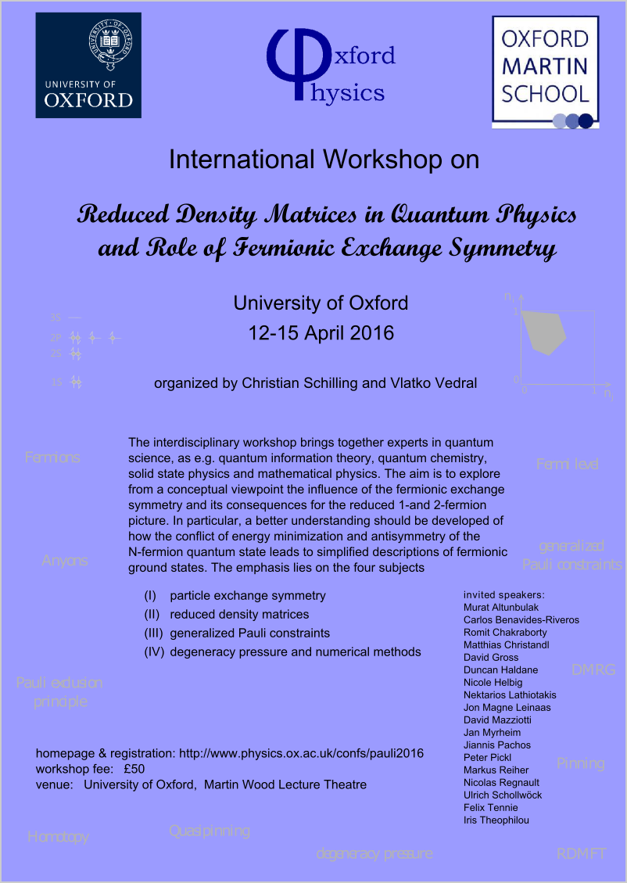
International workshop on this new research field
See website
www.physics.ox.ac.uk/confs/pauli2016
for recorded talks, slides, posters,...

Slide 46
2) Relevance of (quasi)pinning
pinning
point on boundary :
restricted dynamics
0
1
decay
impossible
generalization of:

Slide 47


structual simplifications for N-fermion state
1
0
1
stable:

Slide 48





Slide 49


Slide 50

3a) Ground state problem

Slide 51

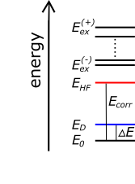
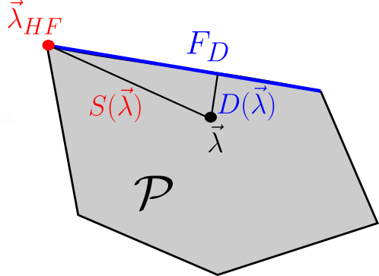
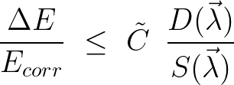

Slide 52




Hierarchy of MCSCF ansatzes

Slide 53


detector
physical
system
1
[CS, Phys. Rev. B 92, 155149 (2015)]
0
1

