Slide 1






Diverging exchange force and form of the
exact density matrix functional
Notes:
1

Slide 2
Outline
(I) Introduction into RDMFT
(II) Geometric picture underlying RDMFT
Translationally-invariant systems
(solid state physics, ultracold fermionic atoms)

Slide 3


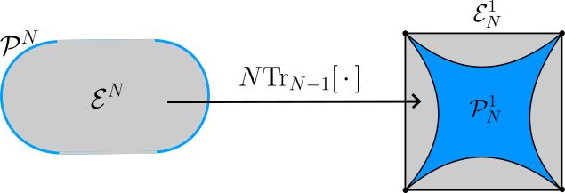
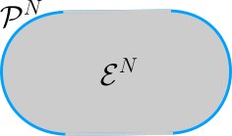






(I) Introduction into RDMFT

Slide 4


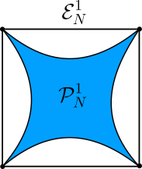






Slide 6







Slide 7














Slide 8


(II) Geometric picture underlying RDMFT

Slide 9



Slide 10



Slide 11




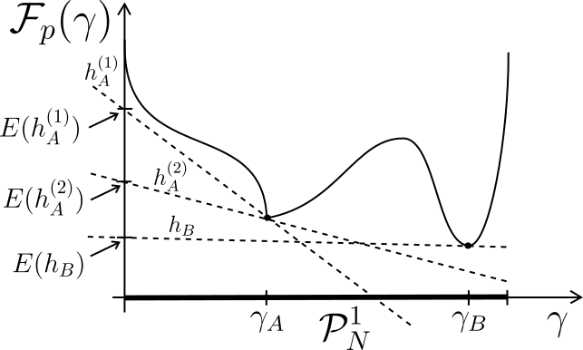

Slide 12

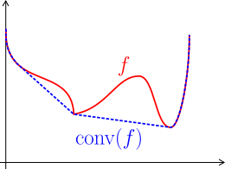





Slide 13


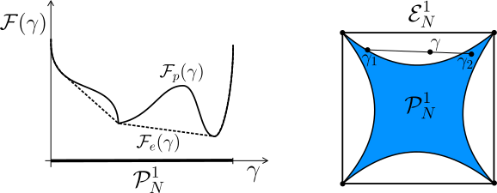



Slide 14


Translationally-invariant systems

Slide 15
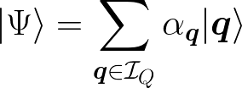


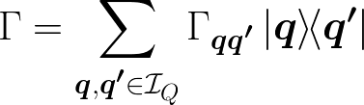

Slide 16



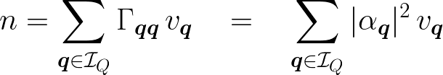





Slide 17







Slide 18



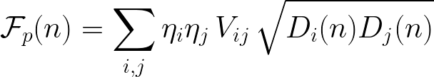

Slide 19


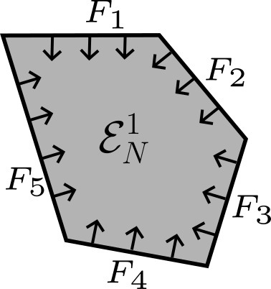


Slide 20
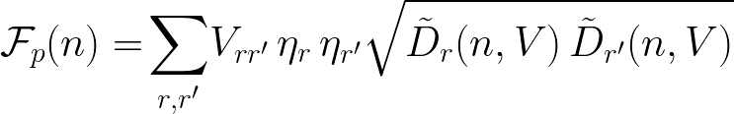



Slide 21
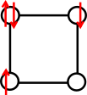


Application/Illustration: Hubbard square

Slide 22

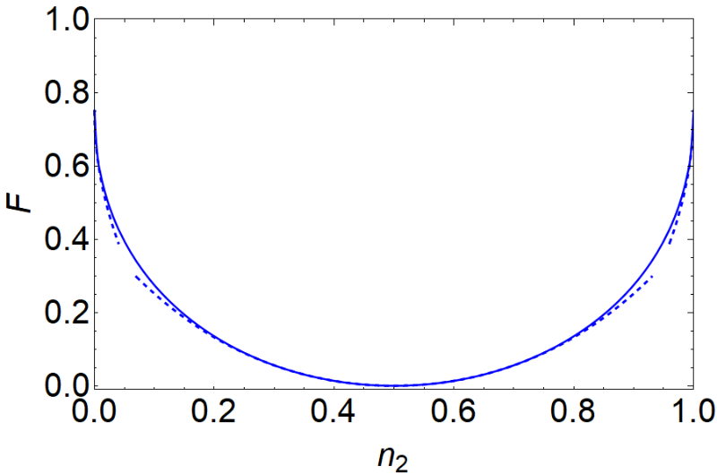
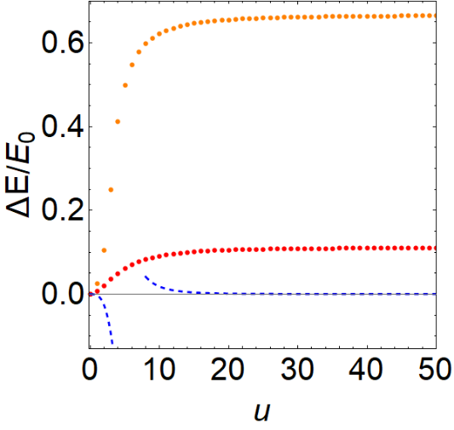

Slide 23


Summary and Conclusion

Slide 24
Outlook and open Problems

Slide 25
Thank you!

Slide 26






Slide 27








Slide 28









Slide 29

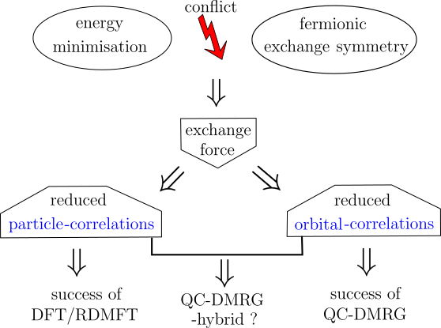

Slide 30

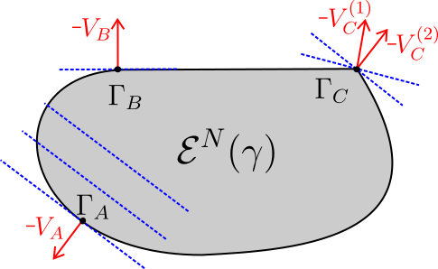


Slide 31



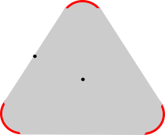



Slide 32


Slide 33
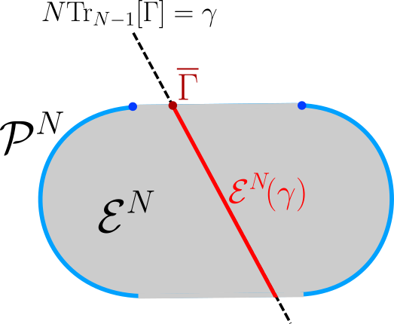



Slide 34
